Slide 1
Mendelian Randomization Study and Power

Slide 2
Cystatin C and cardiovascular disease: an example Mendelian randomization study
What you should know before we start
So why do a Mendelian Randomization?
What is cystatin C and why are we interested anyway?
Who was a friar and what does he have to do with cystatin C?
What is the chicken and what is the egg?

Slide 3
3 Things YOu Should Know Before we Start

Slide 4

We are all equally unique ~100 million genetic variations are known to date among ~3 billion base pairs in the human genome

Slide 5
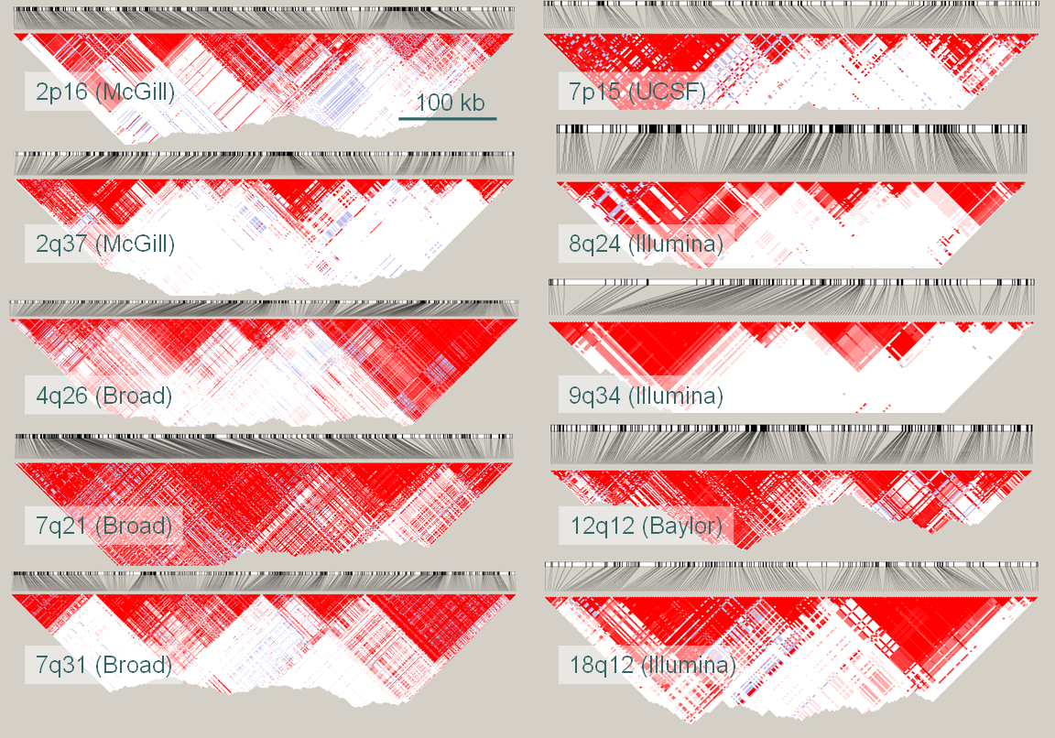
These genetic variants, i.e. single-nucleotide polymorphisms (SNPs), are correlated…
The International HapMap Project. Nature; 426:789-796; 2003
Pe’er I. Genet Epidemiol; 32(4):381-385; 2008
Dudbridge F. Genet Epidemiol; 32(3):227-234; 2008
Notes:
You could look at some part of the genome of 4 individuals – chr 1 through 4
And see that they are all the same – as we’d expect, except for three variations
It turns out there are many more
And it turns out they seem to co-occur in patterns: “haplotypes” 1 through 4
If you look closer you’d only have to look at three of those variants in these haplotypes to know what other variations these individuals must have
So: variants are correlated some more than others

Slide 6
…and form haplotypes…
~ 1 million uncorrelated variants – thus p < 5x10⁻⁸
The International HapMap Project. Nature; 426:789-796; 2003
Pe’er I. Genet Epidemiol; 32(4):381-385; 2008
Dudbridge F. Genet Epidemiol; 32(3):227-234; 2008
Notes:
You could look at some part of the genome of 4 individuals – chr 1 through 4
And see that they are all the same – as we’d expect, except for three variations
It turns out there are many more
And it turns out they seem to co-occur in patterns: “haplotypes” 1 through 4
If you look closer you’d only have to look at three of those variants in these haplotypes to know what other variations these individuals must have
So: variants are correlated some more than others

Slide 7
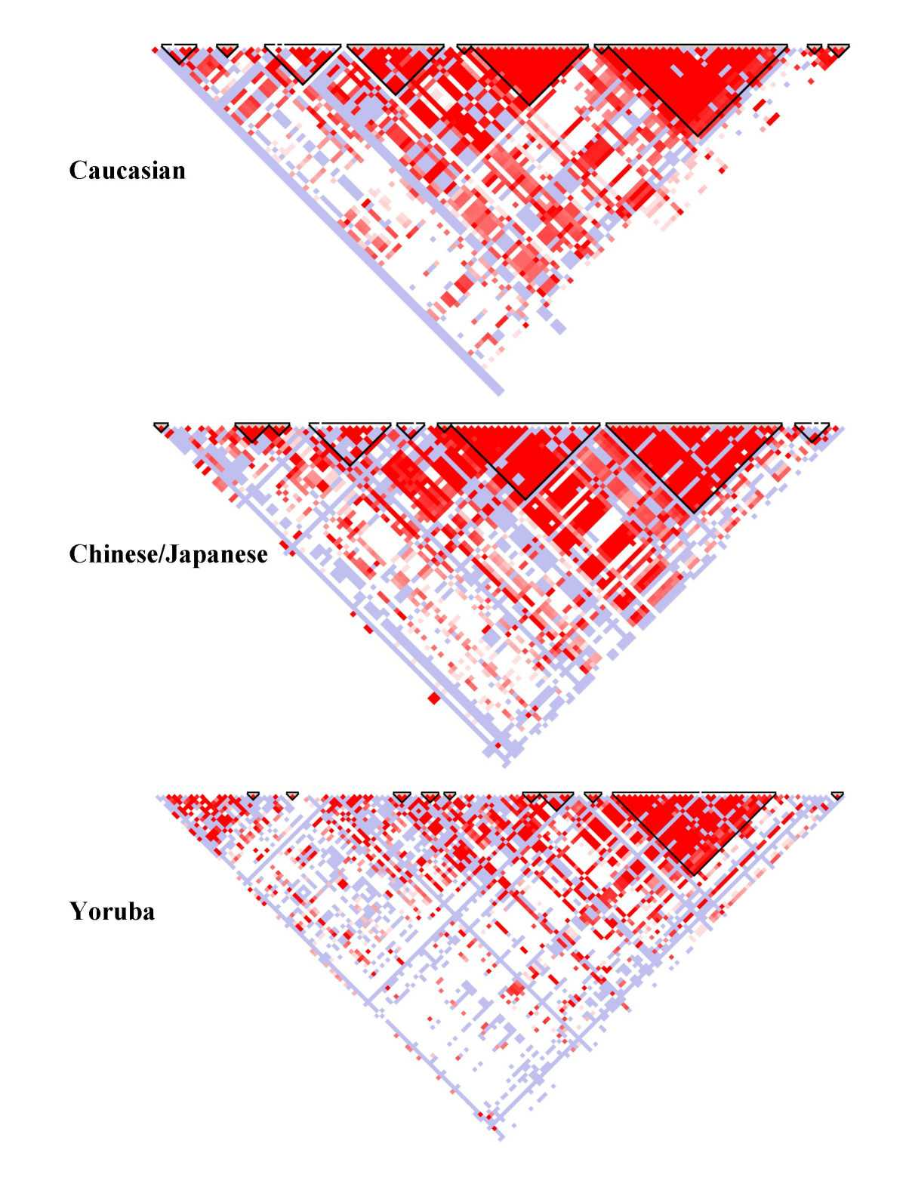
…that differ between ancestral populations…
The International HapMap Project. Nature; 426:789-796; 2003
Pe’er I. Genet Epidemiol; 32(4):381-385; 2008
Dudbridge F. Genet Epidemiol; 32(3):227-234; 2008
Notes:
You could look at some part of the genome of 4 individuals – chr 1 through 4
And see that they are all the same – as we’d expect, except for three variations
It turns out there are many more
And it turns out they seem to co-occur in patterns: “haplotypes” 1 through 4
If you look closer you’d only have to look at three of those variants in these haplotypes to know what other variations these individuals must have
So: variants are correlated some more than others

Slide 8
Common diseases and traits are complex and polygenic by nature
many SNPs are involved with small effects
Asselbergs F.W., van der Laan S.W., de Bakker P.I.W. NTvG; 159:A5821; 2014
Notes:
Common diseases and traits are complex and polygenic by nature
So many variants contribute to them
And all exert a small effect

Slide 9
Asselbergs F.W., van der Laan S.W., de Bakker P.I.W. NTvG; 159:A5821; 2014

Slide 10
So now you know 3 things
We are all equally unique: ~100 million genetic variations are known to date, among ~3 billion base pairs in the human genome
These genetic variants, i.e. single-nucleotide polymorphisms (SNPs), are correlated and form haplotypes that differ between ancestral populations
Common diseases and traits are complex and polygenic by nature: many SNPs are involved with small effects

Slide 11
Why do a Mendelian Randomization Study?

Slide 12
Biomarkers
Drug targets

Slide 13
Biomarkers
Is the relationship between biomarker and disease causal?
Drug targets

Slide 14
Biomarkers
Is the relationship between biomarker and disease causal?
Drug targets
What are the consequences for biomarkers or risk factors when you specifically modulate a target?

Slide 15
Observational studies are inherently problematic
Many complex diseases (and traits) are by confounders
Reverse causation further complicates the interpretation
Smoking
BMI
Flu
CRP
Cardiovascular disease
Inflammation
Atherosclerosis

Slide 16
The concept of Mendelian Randomization

Slide 17
Katan, MB. Lancet 1986

Slide 18
Katan, MB. Lancet 1986

Slide 19
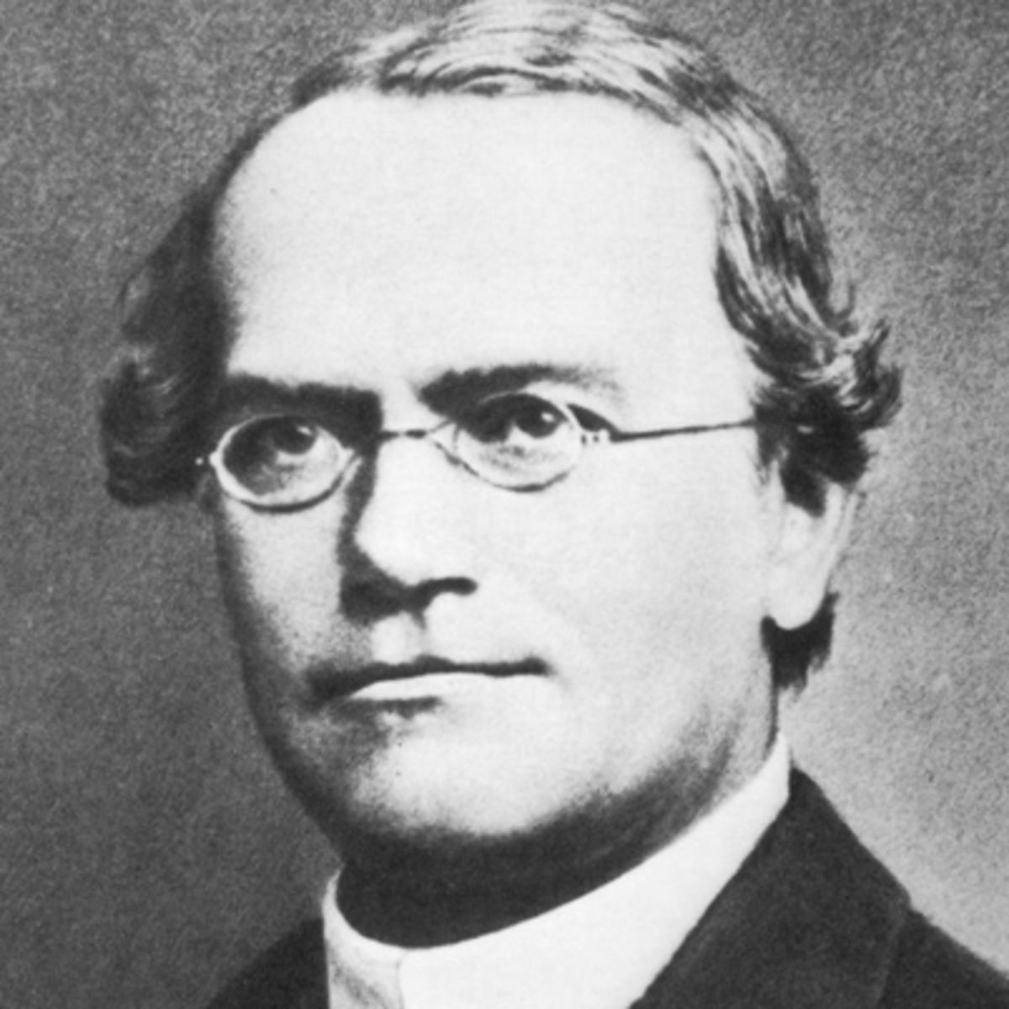
Gregor Johann Mendel - 20 July 1822 – 6 January 1884

Slide 20
Can you name the Laws of Mendel?
Van der Laan S.W. 2017. ISBN 978-90-393-6639-4

Slide 21
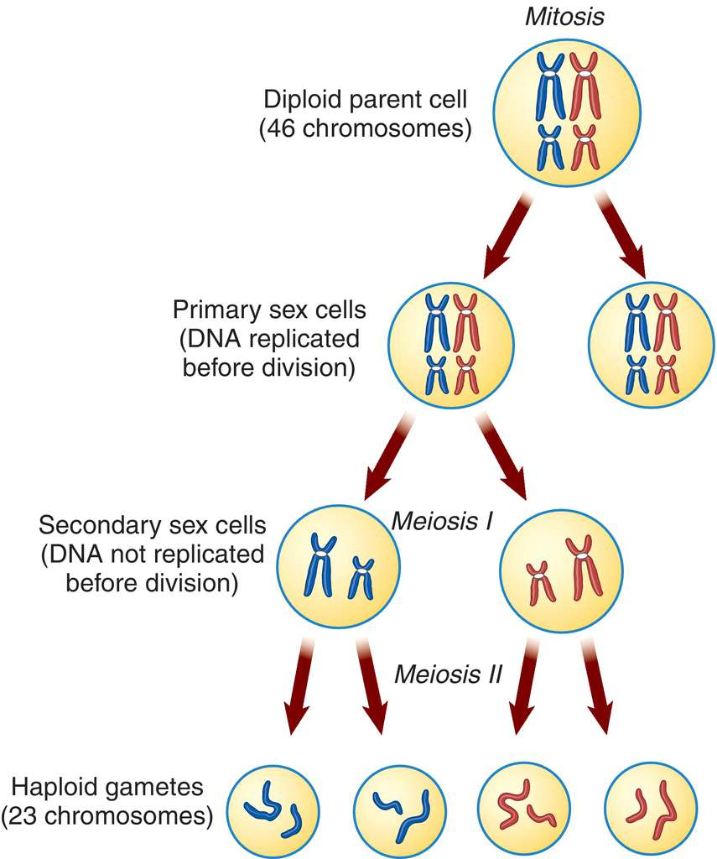
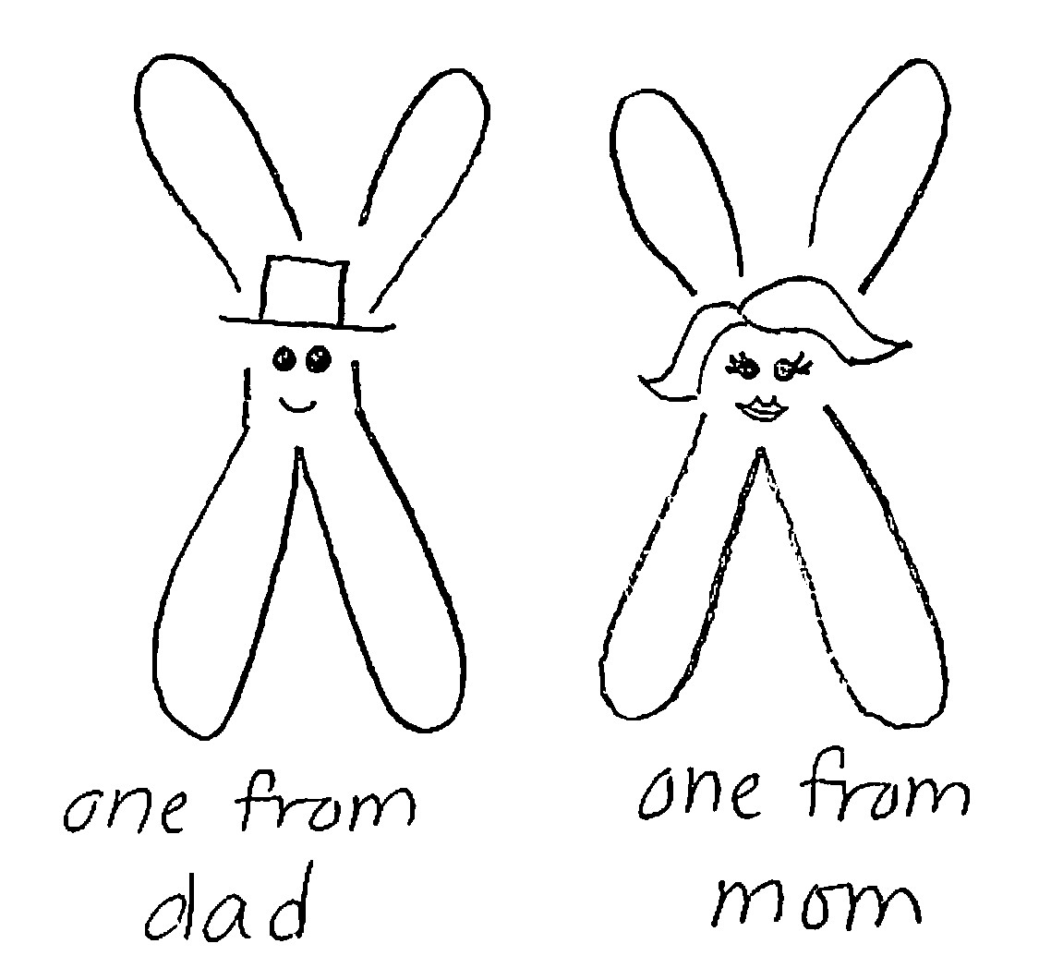
#1: Law of Seggregation
Process where a single cell divides 2 times to produce 4 cells containing half of the original amount of genetic information

Slide 22
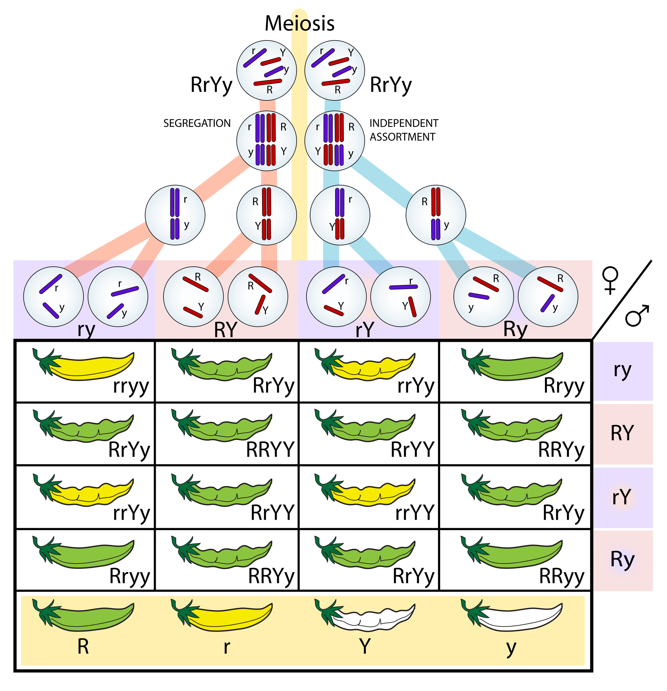
#2: Law of Independent Assortment

Slide 23
Can you name the Laws of Mendel?
Van der Laan S.W. 2017. ISBN 978-90-393-6639-4

Slide 24
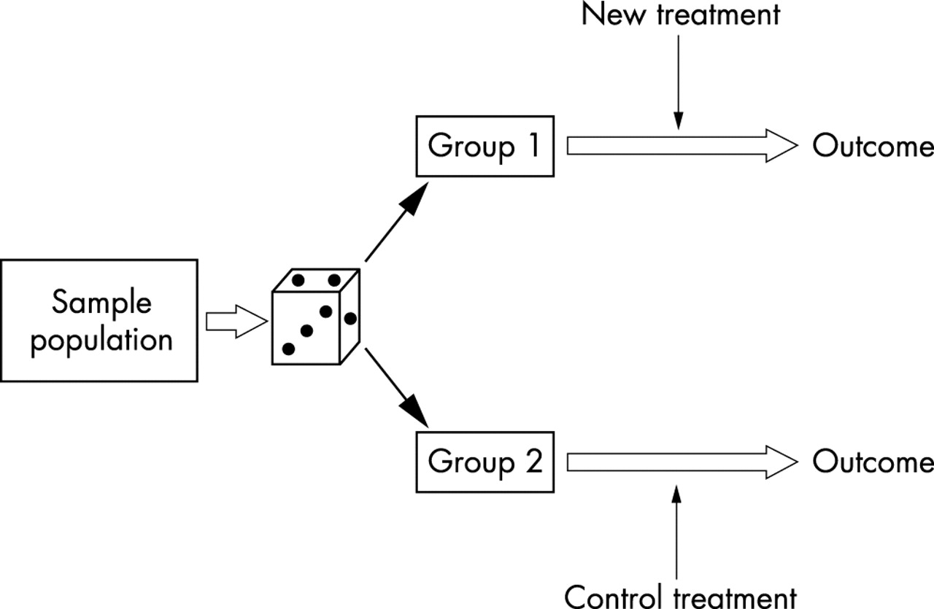
Alleles are randomly assigned: a “natural” treatment in a “natural” randomized trial
Katan, MB. Lancet 1986

Slide 25
Alleles are randomly assigned: a “natural” treatment in a “natural” randomized trial
Katan, MB. Lancet 1986

Slide 26
Mendelian Randomization Studies: why
Alleles are randomly, and independent assorted
Eliminates confounding
Useful and cheap – especially when there are…
…no drugs,
…the trial is not feasible…
…or not ethical

Slide 27
Do you know what the Central Dogma and how does it relates to Mendelian Randomization?

Slide 28
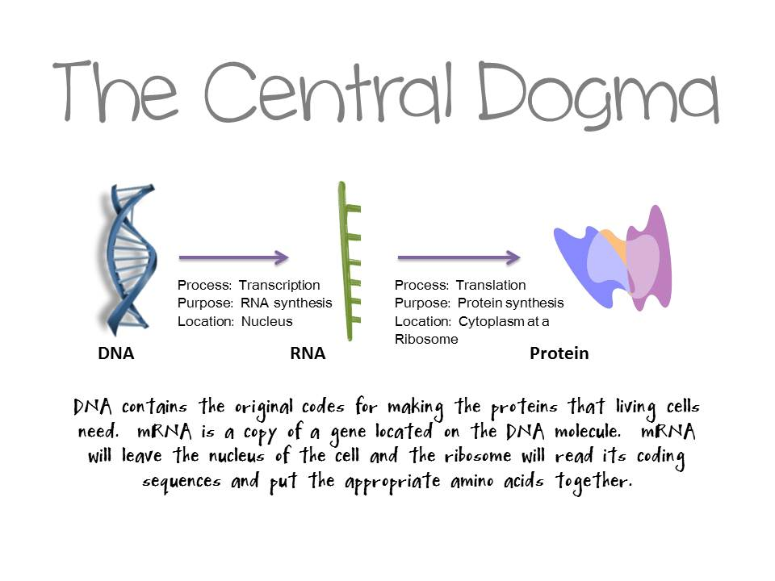

Slide 29
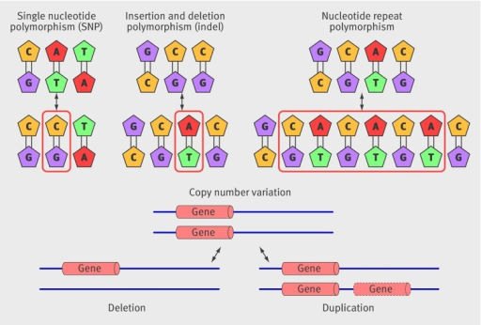
Many types of genetic variants

Slide 30
Many types of genetic variants

Slide 31
Many types of genetic variants

Slide 32
Many types of genetic variants

Slide 33
Genetic variants influence proteins
GWAS of biomarkers identified many associated loci
Genetic variant should be…
…robustly associated to the biomarker (a strong “instrument”)
…independent of any potential confounder
…indirectly associated to the ‘endpoint’, i.e. via the putative causal biomarker
…common enough in the general population (why?)

Slide 34
The concept of Mendelian Randomization
Confounding factors
ApoE
Serum cholesterol
Cancer

Slide 35
The concept of Mendelian Randomization
Use genetic variants independent of any confounder
Include prospective studies to reduce reverse causation
Include deeply phenotyped studies to correct for potential confounders in the observational analysis

Slide 36
An example MR Study
Cystatin C and Cardiovascular Disease

Slide 37
Background
Cystatin C and Cardiovascular Disease

Slide 38
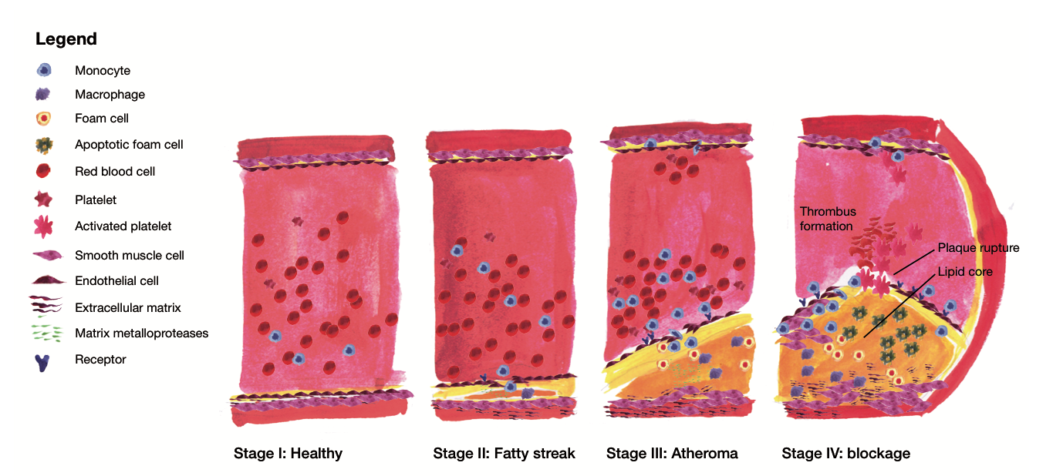
Atherosclerosis is the primary underlying cause of cardiovascular disease
Van der Laan S.W. 2017. ISBN 978-90-393-6639-4

Slide 39
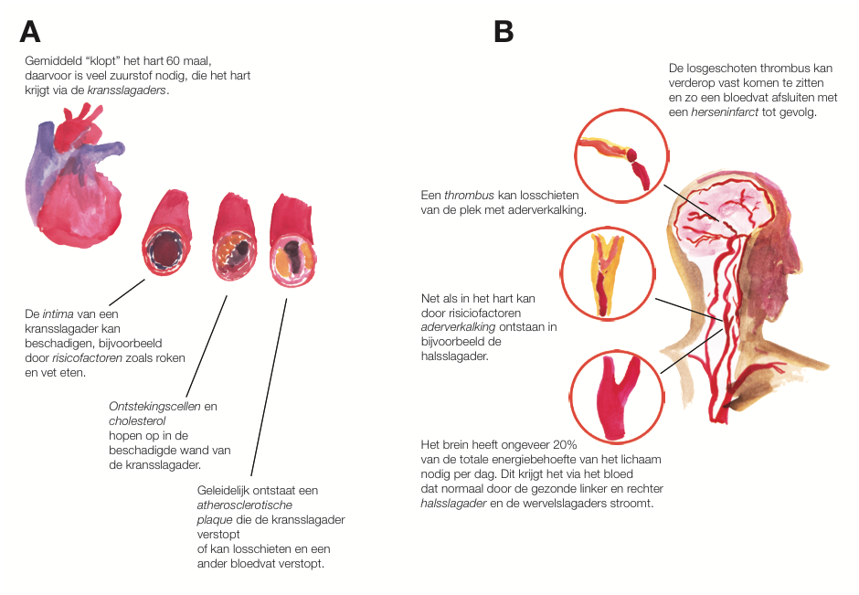
CVD: myocardial infarction or cerebrovascular accident (a.k.a. stroke)
Van der Laan S.W. 2017. ISBN 978-90-393-6639-4

Slide 40
Cystatin C (CystC)
Encoded by CST3 on 20p11.21
“Protease inhibitor”
It inhibits the activity of cathepsins (cysteine proteases) in vascular smooth muscle cells
Prevention of plaque formation by binding amyloid-beta precursor protein (APP) in Alzheimer’s disease
Shi et al. JCI 1999; Kaeser et al. Nat Genet 2007; Mi et al. Nat Genet 2007

Slide 41
A role in human and murine atherosclerosis
Reduction of CystC in abdominal aortic aneurysm (in smooth muscle cells)
Lack of CystC in ApoE^{-/-} mice promotes atherosclerosis
Shi et al. JCI 1999; Bengtsson et al. ATVB 2005

Slide 42
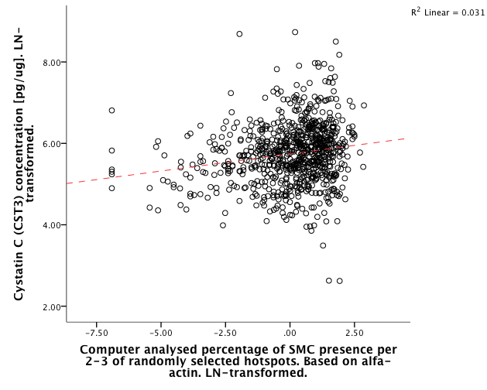
In carotid plaques CystC positively correlates with the percentage of smooth muscle cells
Rho = 0.185 (R = 0.176)
p = 1.10x10⁻⁷
Van der Laan et al. unpublished

Slide 43
CystC in atherosclerosis
Van der Laan S.W. et al. JACC 2016

Slide 44
CystC as a biomarker for CKD
One of the best naturally occurring biomarker for human estimated glomerular filtration rate (eGFR)
It is a better biomarker than creatinine when eGFR>90 (mL/min/1.73m³)
Fried et al. Kid Intern 2009; Inker et al. NEJM 2012
Notes:
Chronic kidney disease epidemiology collaboration formula/equation

Slide 45
Epidemiological evidence
In elderly without chronic kidney disease (CKD), CystC is prognostic of death, cardiovascular disease (CVD) and CKD
Asymptomatic carotid atherosclerosis patients, CystC prognostic for CVD
CystC associated with lesion size in acute stroke

Slide 46
Literature meta-analyzed
CystC is associated with a higher risk of CVD, stroke and mortality in high-risk populations
Lee et al. Circ CQO 2010

Slide 47
Clinical applications
2 observational studies and 5 clinical trials focused on
Biomarker for diagnosis and prognosis
Marker of efficacy (treatment)
At least one drug in development: “RO4905417/INCLACUMAB” to reduce damage during PCI (Roche)
Patents
Cavadis B.V.: exosome derived biomarker for adverse cardiovascular events (several patents [pending])
Biomarker for peripheral artery disease (2469279)
CystC as a “drug” for the treatment of atherosclerosis (WO/2001/030370)
Roche: selection of therapy in heart failure (WO/2014/086833)
Siemens: biomarker for pulmonary hypertension (WO/2014/052803)

Slide 48
Hypothesis…
There is an large body of evidence from human and murine experiments and specimens that CystC is involved in atherosclerosis
Epidemiological studies show that CystC is associated with increased risk CVD
Plaque CystC and the percentage of SMCs in plaques are correlated
Is CystC causal to cardiovascular disease?

Slide 49
Fulfilling assumptions
Cystatin C and Cardiovascular Disease

Slide 50
SNP selection
Fulfilling assumptions

Slide 51
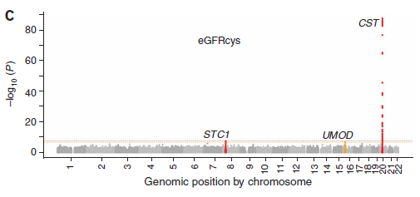
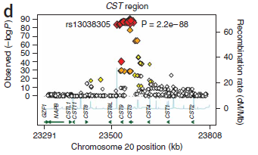
GWAS: locus with CST3 pops up (naturally)
Four Genome–Wide Association Study Meta-Analyses of eGFR and CKD revealed a region containing CST3 (Cystatin C) as significantly associated
Identification of three loci associated with eGFRcys aka CystC expression: STC1, UMOD, CST3
Köttgen et al. Nat Genet 2009
March 28, 2017 | 51

Slide 52
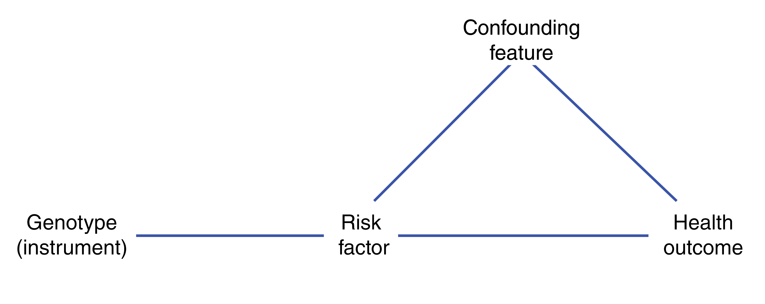
SNP selection
One GWAS on CystC, rs1158167 in Framingham Heart Study
Three (meta-analyses of) GWAS on eGFR_{CystC}
rs911119, rs13038305
eGFR_{CystC} = 76.7 x (serum CystC)^{-1.19}
Log linear relation between serum CystC and eGFR
Van der Laan S.W. et al. JACC 2016

Slide 53
SNP selection
Van der Laan S.W. et al. JACC 2016

Slide 54
SNP selection
Van der Laan S.W. et al. JACC 2016

Slide 55
Studies & Confounding
Fulfilling assumptions

Slide 56
Studies included
Van der Laan S.W. et al. JACC 2016

Slide 57
Serum cystatin C vs. risk factors
Van der Laan S.W. et al. JACC 2016

Slide 58
Cystatin C variant vs. risk factors
Van der Laan S.W. et al. JACC 2016

Slide 59
SNP vs. cystatin C
Per minor allele there is 6.13% decrease in CystC [mg/L]
β = -0.09 [-0.10 – -0.09], p = 5.95x10⁻¹⁶³ , N = 29,805
This explains ≈2.75% of the phenotypic variation
Van der Laan S.W. et al. JACC 2016

Slide 60
Observational analysis
Minimally adjusted model: age + sex
Van der Laan S.W. et al. JACC 2016

Slide 61
Observational analysis
Minimally adjusted model: age + sex
Fully adjusted model: age + sex + HDL + systolic blood pressure + BMI + smoking status + CKDEPI
Van der Laan S.W. et al. JACC 2016

Slide 62
Mendelian randomization analysis
Minimally adjusted model: age + sex
Fully adjusted model: age + sex + HDL + systolic blood pressure + BMI + smoking status + CKDEPI
Causal effect: nada, nothing, niets, rien, nichts, ничего
Interaction analysis: significant – models are different
Van der Laan S.W. et al. JACC 2016

Slide 63
Other outcomes
Van der Laan S.W. et al. JACC 2016

Slide 64
Power?
Fulfilling assumptions

Slide 65
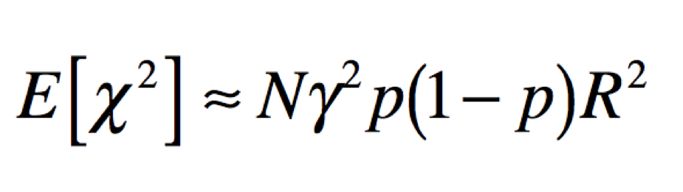
Power
Power to detect association
LD with causal variant
Effect size
Sample size
Allele frequency

Slide 66
The power problem

Slide 67
Did we have power?
Van der Laan S.W. et al. JACC 2016

Slide 68
So actually you have learned more today…
There is a correlation between the percentage of SMCs and CystC in plaques, and CystC levels appear to be lower in SMCs from AAAs
Strong epidemiological evidence exists for a role of CystC in CVD
Variants in CystC associated with serum CystC levels, eGFR_{CystC}
MR analysis: we find no evidence for a causal effect of CystC on CVD
Van der Laan S.W. et al. JACC 2016

Slide 69




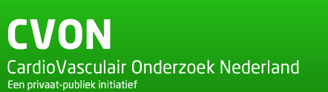
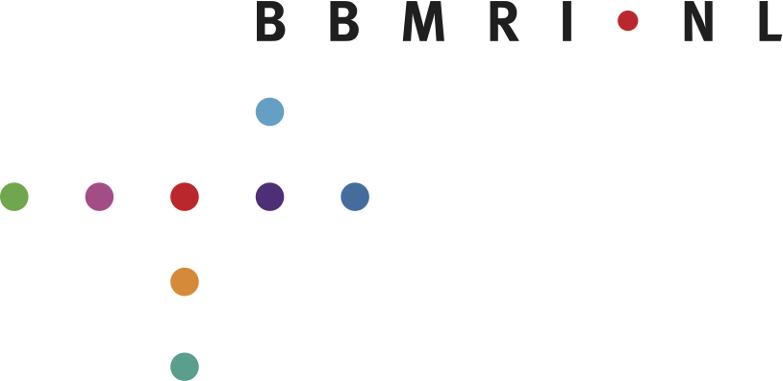






Acknowledgements
Supervisors & Mentors
Gerard Pasterkamp, Paul de Bakker, Folkert Asselbergs, Hester den Ruijter & Dominique de Kleijn
Department Vascular Surgery
Frans Moll, Gert-Jan de Borst & Jean-Paul de Vries
Department of Pathology
Aryan Vink & Petra van der Kraak
Uppsala University, Sweden
Tove Fall, Johan Ärnlöv
Penssylvania University, Philadelphia
Michael V. Holmes
Data Acquisition
Arjan Schoneveld, Sander van de Weg, Loes Collé, Claudia Tersteeg, Evelyn Velema, Mirjam Smeets, Pleunie van den Borne, Sanne Willems & Kristy Vons
Data Analysis
Jessica van Setten, Kim Jie & Joyce Vrijenhoek, Vinicius Tragante do Ó
Financial support
ICIN (09.001), GENIUS (CVON2011-19), FP7 EU project CVgenes@target HEALTH-F2-2013-601456, BBMRI CP2013-63, Cavadis B.V.
Disclosure: this work is partly financed by Cavadis
www.cavadis.com

Slide 70
A Mendelian Randomization study in practice

Slide 71
What do we need?
Can you think of the elements needed for a MR study?

Slide 72
What do we need?
Can you think of the elements needed for a MR study?
Relevant question – duh
SNP → where, how?
Biomarker → observational analyses
Outcome → observational analyses
Studies → observational analyses, PubMed
Power → R script, online tools
Analysis plan
Time

Slide 73
Your question leads you to…
Your biomarker & Outcome
The studies → search PubMed
…and your SNP selection…
PubMed
GWAS Central
GTEx Portal

Slide 74
Calculate Power
There are a couple of sites:
https://sb452.shinyapps.io/power/
https://cnsgenomics.shinyapps.io/mRnd/ -- a bit more extensive
Assignment

Slide 75
Calculate Power: assignment
PubMed: Elliott P et al. JAMA 2009
Calculate power given their data using one of the aforementioned calculators

Slide 76
Perform a MR study…
…wait…what?
Yes, you can: http://www.mrbase.org/beta/

Slide 77
Perform a MR study…: assignment
Think of your favorite gene/biomarker…
…find an appropriate SNP…,
…and your favorite outcome measure (can also be continuous)…,
…and use the website to perform the MR
But hold on: there are couple of other decisions you’ll have to make… ☺

Slide 78
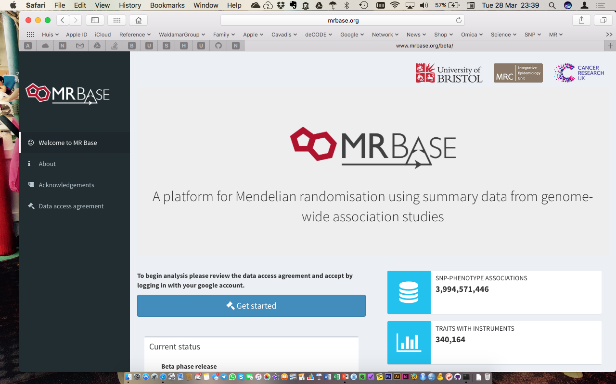
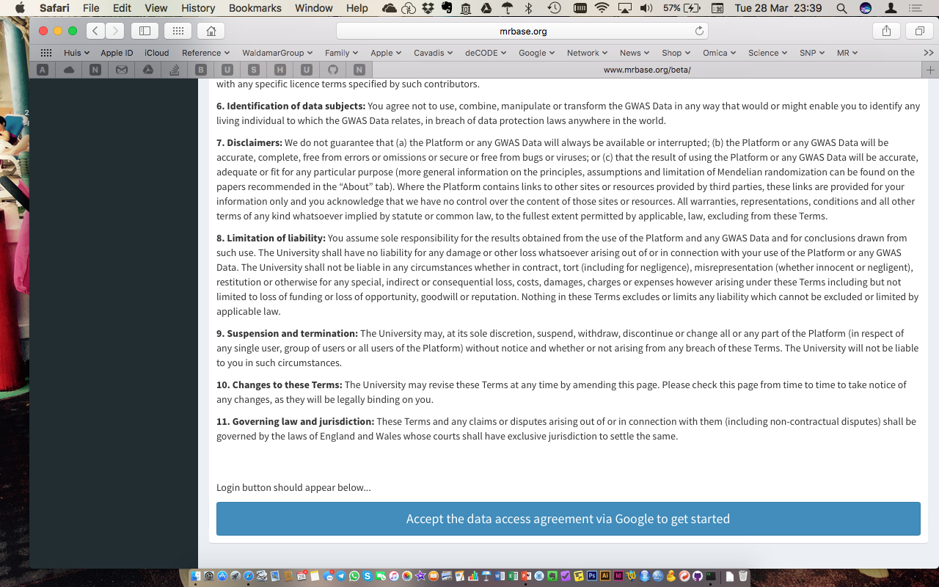

Slide 79
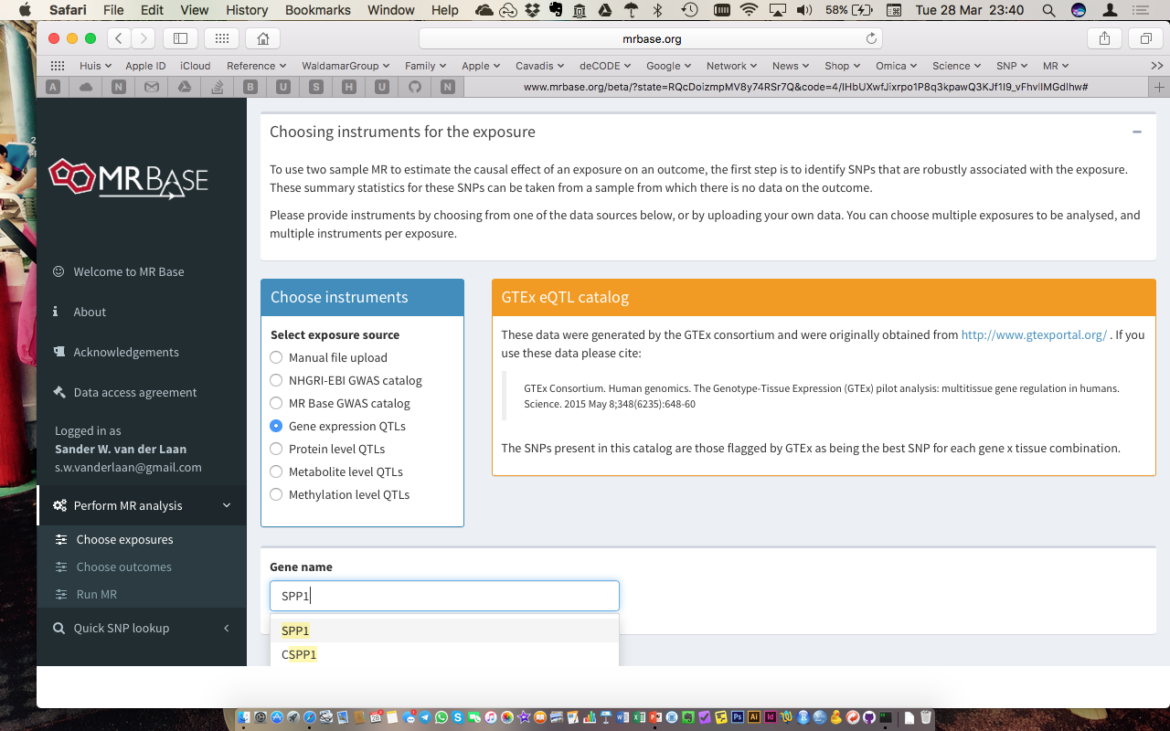

Slide 80
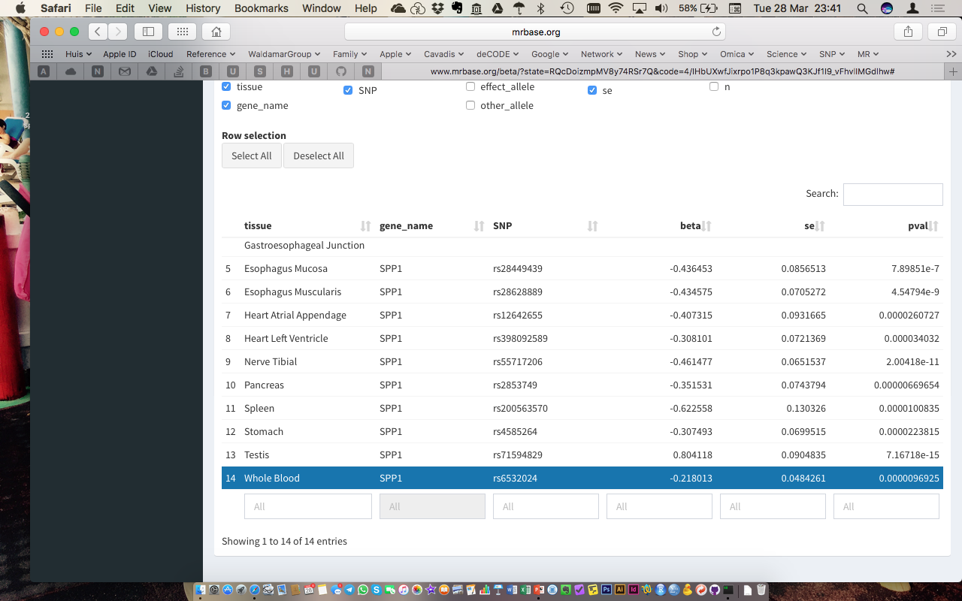

Slide 81
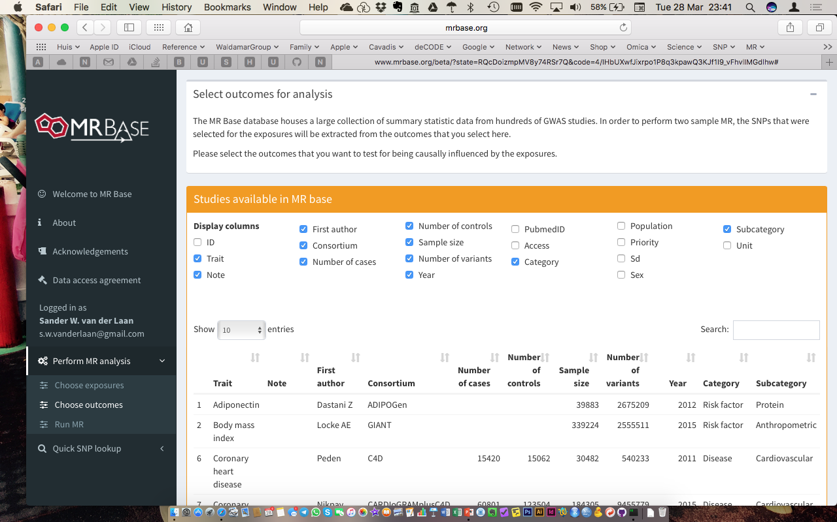
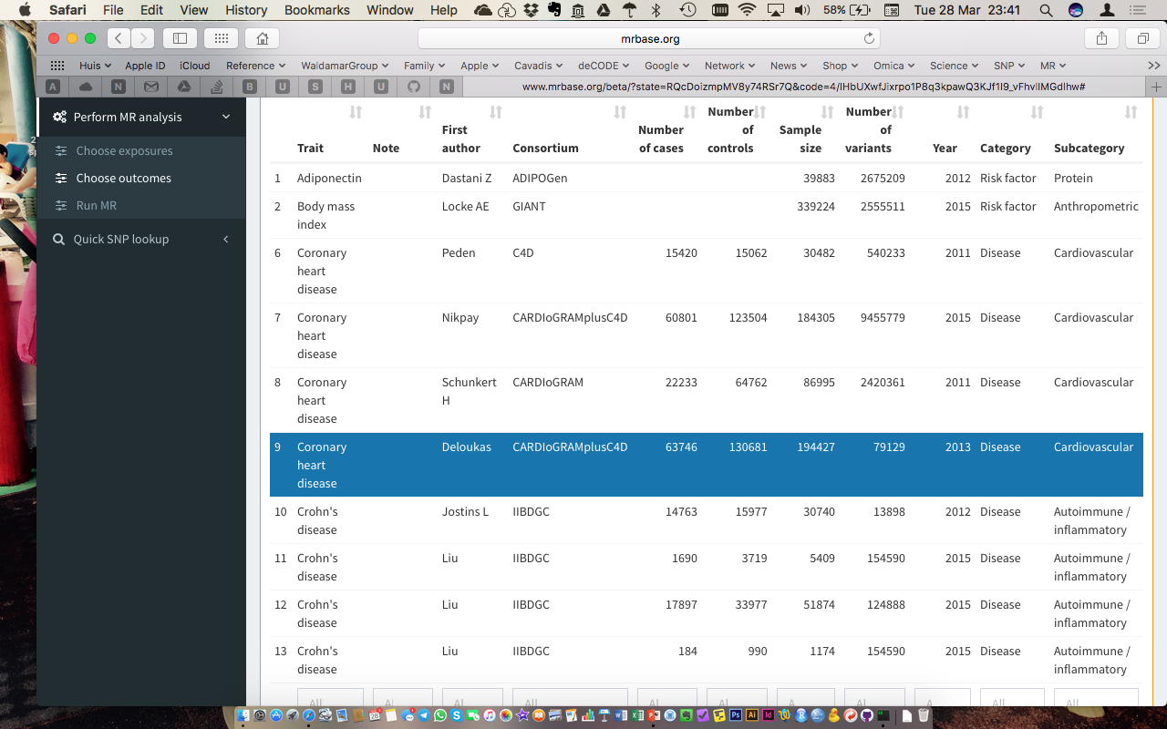

Slide 82
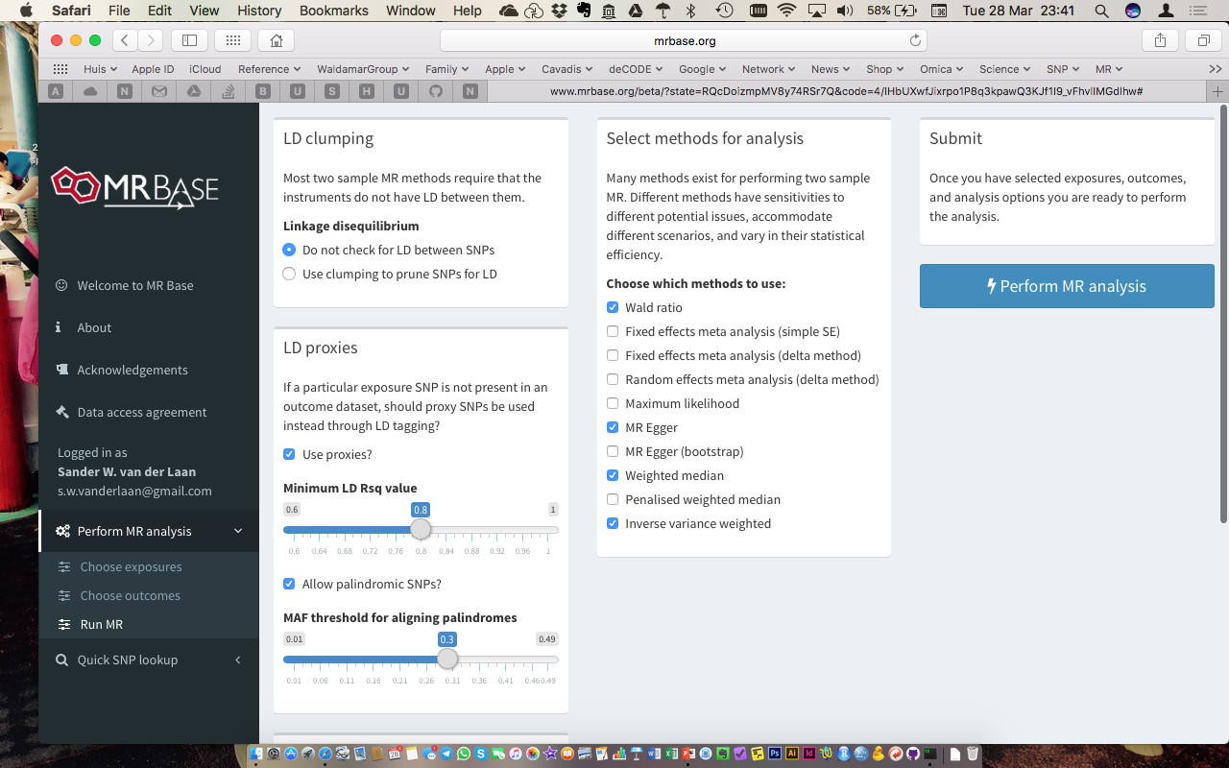

Slide 83
Do we need to LD prune our SNP selection…?
Select a method for MR…
How do we handle missing SNPs…?
What do we do with A/T and C/G SNPs…?

Slide 84
Why were we Interested?
Cystatin C and cardiovascular disease: a Mendelian randomization study

Slide 85
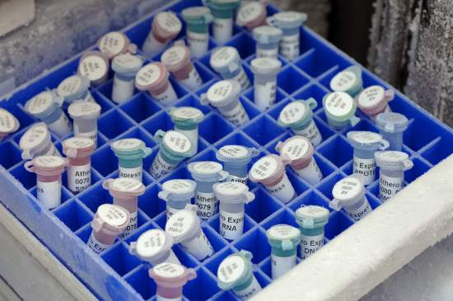
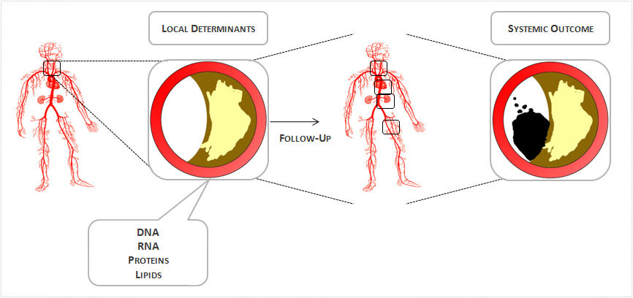
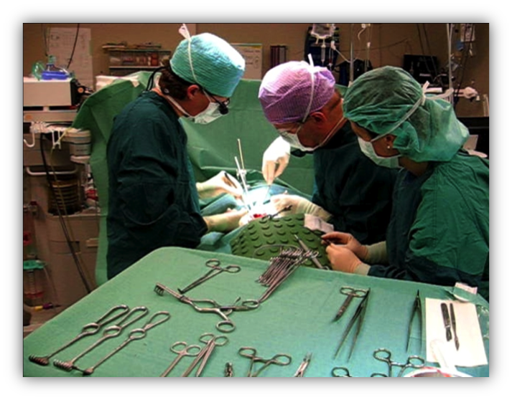
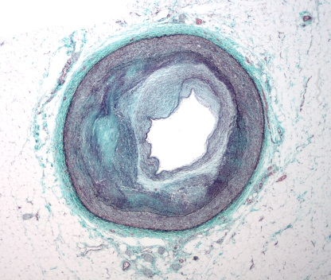
This was the start of our work...
CystC expressed in smooth muscle cells inhibiting cathepsins
CystC is down regulated in AAA samples
ApoE^{-/-}–CystC^{-/-} mice have more atherosclerosis
Is there an association of CystC associated variant with CystC and SMCs in the carotid plaques from the Athero-Express?

Slide 86
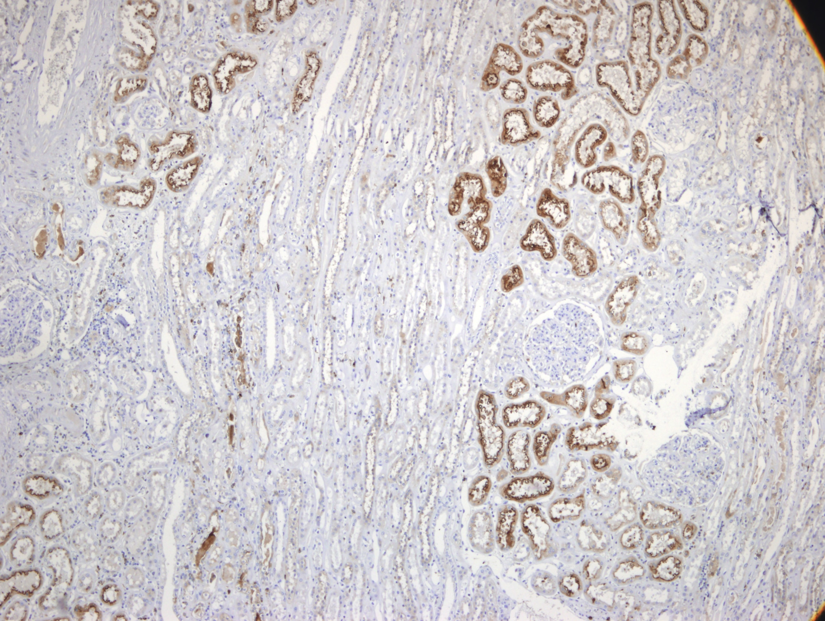
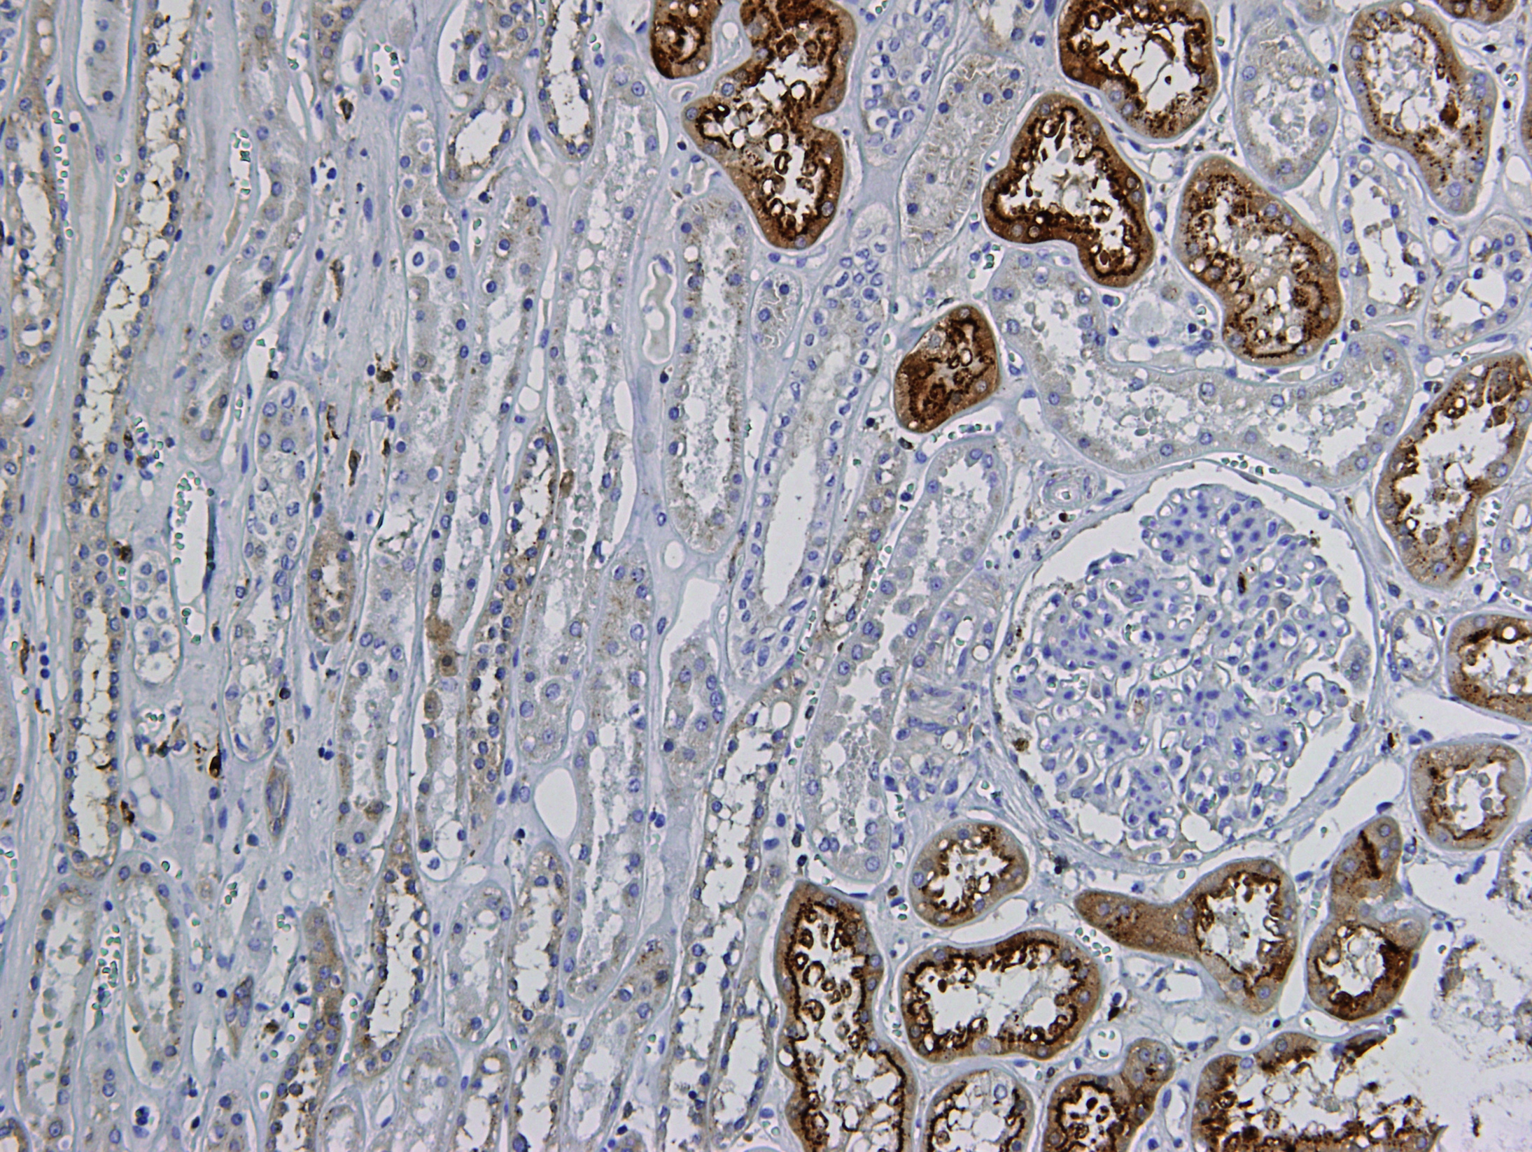
Histological staining for CystC
First a positive control: the human kidney
CystC present in proximal (?) tubuli
Appears to be present in granules
Van der Laan et al. unpublished

Slide 87
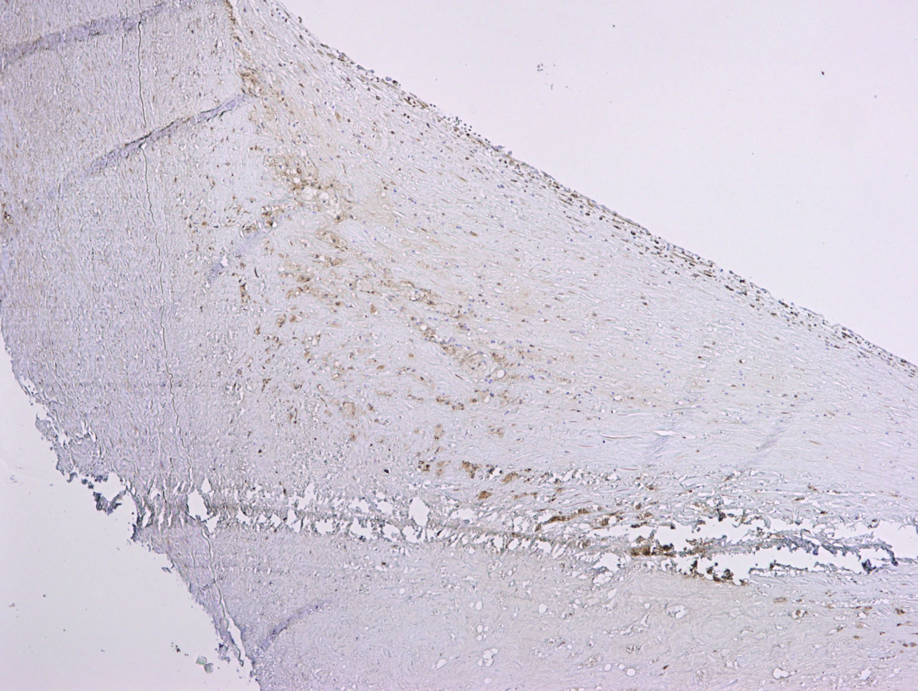
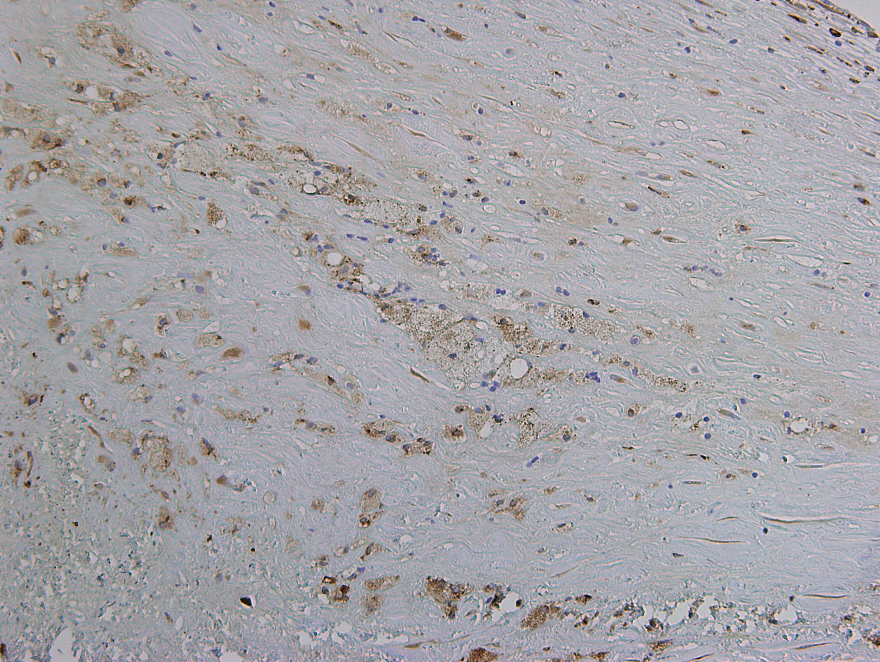
Carotid endarterectomy sample
Shoulder region, clear staining for CystC
Appears to be stronger in foamy cells, (foamy) smooth muscle cells
Van der Laan et al. unpublished

Slide 88
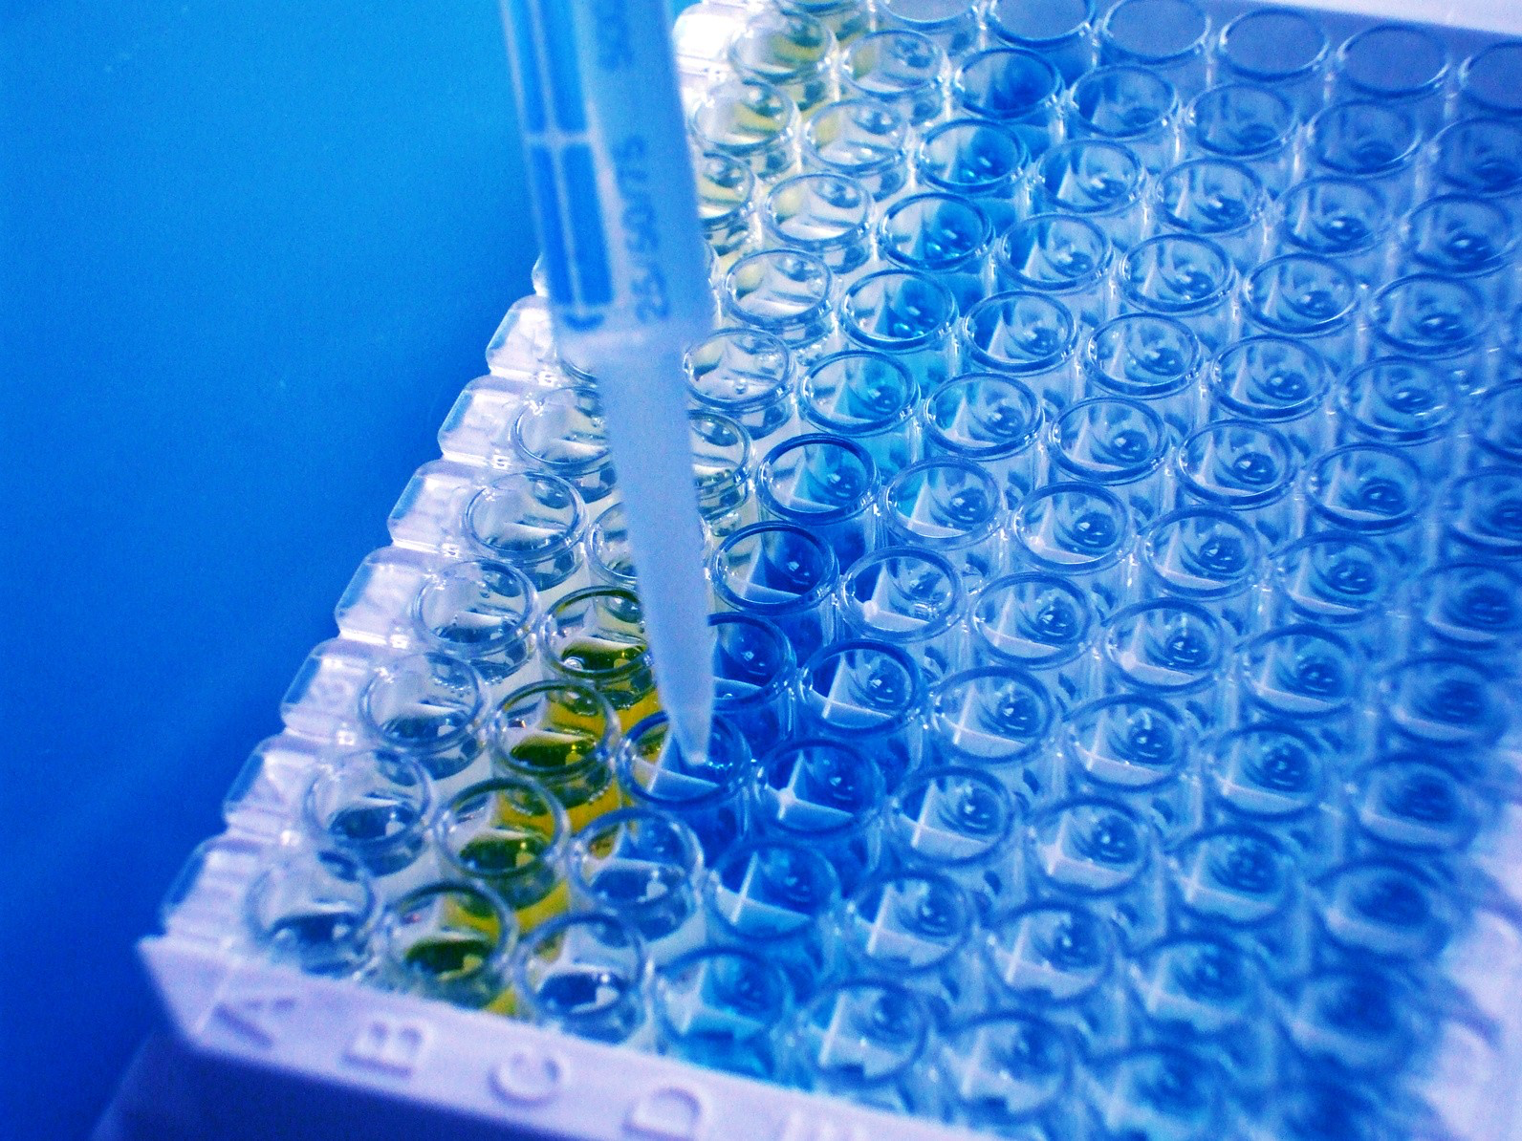
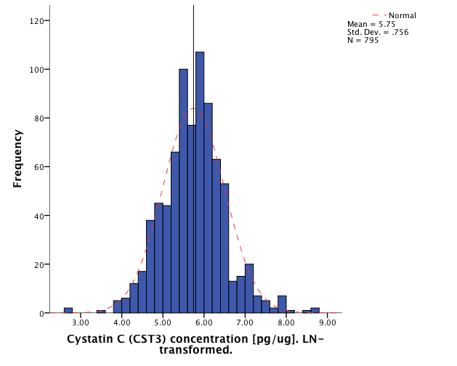
Luminex CystC plaque levels
N = 795
Rho = 0.185 (R² = 0.176), p = 1.10x10⁻⁷
Van der Laan et al. unpublished

Slide 89
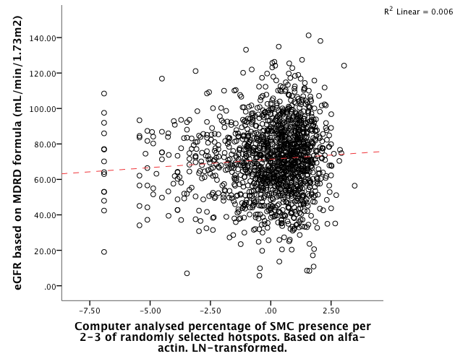
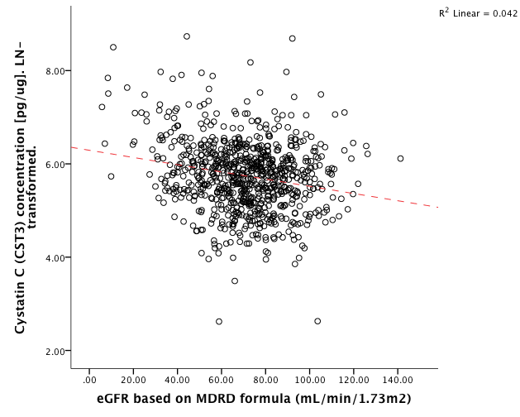
Associations with eGFR
SMC vs. eGFR: Rho = 0.084 (R² = 0.076), p = 1.35x10⁻³
eGFR vs. plaque CST3: Rho = -0.161 (R² = -0.206), p = 4.92x10⁻³
Van der Laan et al. unpublished

Slide 90
CystC-variant associated with SMC in plaques
In Athero-Express Genomics Study 1 (N=571) rs6114208 negatively correlated with SMCs in plaques, p=1.53x10⁻⁶
When analyzed with additional samples (Athero-Express Genomics Study 2, N=868), p = 0.0083, β = -0.161 (0.061), about 10.6% decrease in SMCs
Van der Laan et al. unpublished

Slide 91
Studies & Confounding
Fulfilling assumptions

